Slide 1


Modeling: Electric Circuits

Slide 2
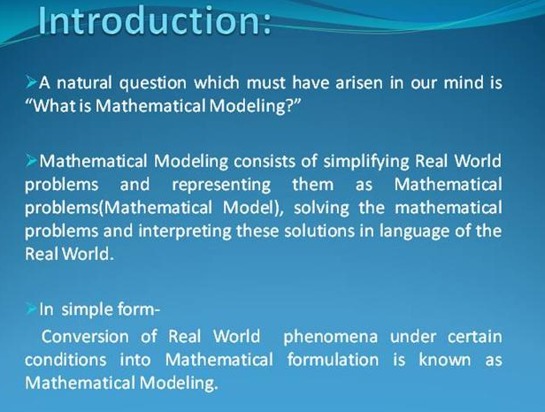

Slide 3
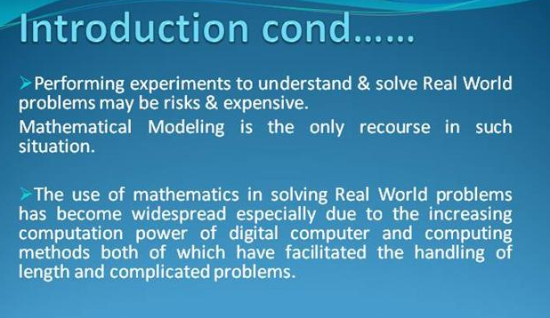

Slide 4
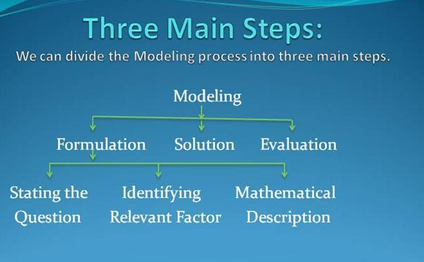

Slide 5
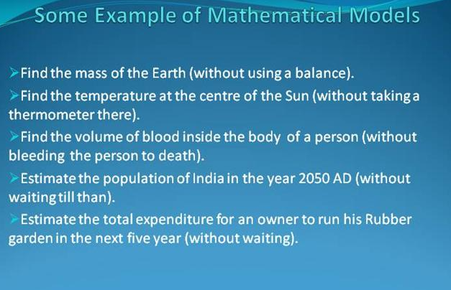

Slide 6
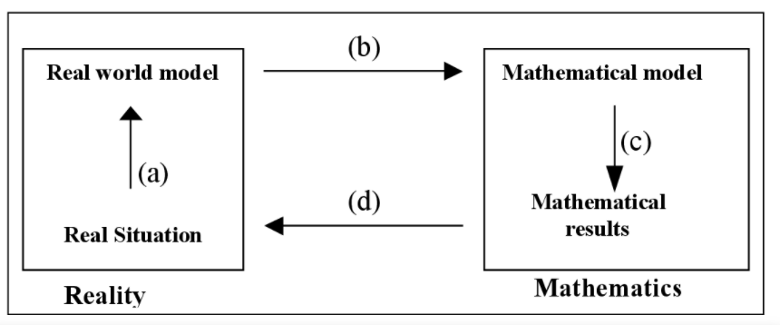
Steps of Mathematical Modelling

Slide 7


Slide 8


Slide 9




Slide 10



Slide 11




Slide 12




Slide 13


Slide 14


Slide 15


Slide 16


Slide 17


Slide 18


Slide 19


Slide 20


Slide 21


Slide 22


Slide 23


Slide 24


